Slide 1
Technology Fundamentals of Business Analytics
Jason Kuruzovich

Slide 2
Agenda
Information and society
What do we mean by being a data scientist?
Let’s get excited about analytics
Analytics Overview
Visualization, Statistics, and Machine Learning
Technology Platforms
Docker
Azure

Slide 3
Classroom Rules
Laptops/phones down when lecture/discussion
Laptops up for exercises and hands on exercises
DON’T WORRY, WE WILL GET A GOOD MIX OF EACH!
See what influenced me:
https://medium.com/@cshirky/why-i-just-asked-my-students-to-put-their-laptops-away-7f5f7c50f368#.h6b8fie71

Slide 4
Me
Director of the Severino Center for Technological Entrepreneurship
Associate Professor of Business Analytics
Research on marketing, multichannel retailing, most recently entrepreneurship

Slide 5
Next Startup Tech Valley Event is September 7 at 5:30 at Brown’s Revolution Hall See more at www.startuptechvalley.org

Slide 6
There have been profound changes in technology and the information processes define our society

Slide 7
Internet 0.1 Beta (18th Century)
Semaphore Telegraph
Visual texting by position of the mechanical elements;
By The drawing is signed "Keith Thomas" in lower right corner [Public domain], via Wikimedia Commons

Slide 8
Internet 0.1 Beta (18th Century)
Over 50 stations connecting France
Shows the extent to which people will go to communicate
By Jeunamateur [CC BY-SA 3.0 (http://creativecommons.org/licenses/by-sa/3.0)], via Wikimedia Commons

Slide 9
“We create as much information in two days now as we did from the dawn of man through 2003.”
-Eric Schmidt, Former CEO of Google

Slide 10




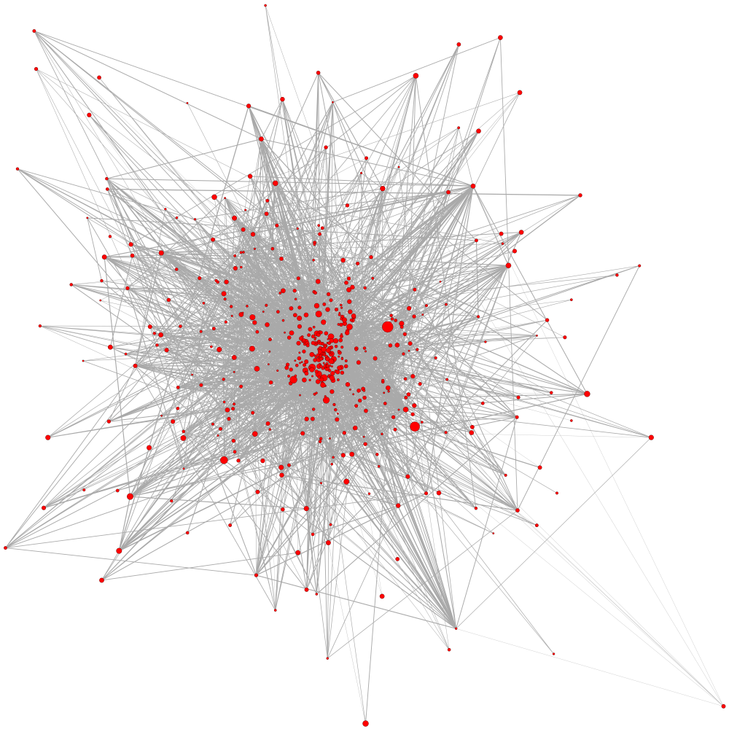

Information Economy
TRADITIONAL PRODUCTION PROCESS
INFORMATION BASED BUSINESS PROCESS
INFORMATION TECHNOLOGY

Slide 11
Internet of Things
“The internet of things (IoT) is the network of physical devices, vehicles, buildings and other items—embedded with electronics, software, sensors, actuators, and network connectivity that enable these objects to collect and exchange data.”
– Internet of Things Global Standards Initiative via Wikipedia.

Slide 12
Web 2.0 Social Networks
Notes:
On top of these technology components we have build something extremely human: A network of personal and professional relationships which we can use for communication among and between friends, relatives, customers, companies, employees, employers, students, and professors. What is powerful about communication is that it can enable action, and this action can change the world around us.

Slide 13
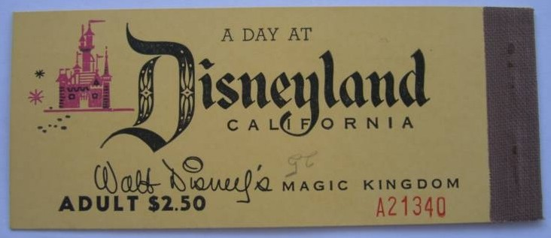
Disney
ROLE OF DATA: How many tickets did we sell?

Slide 14
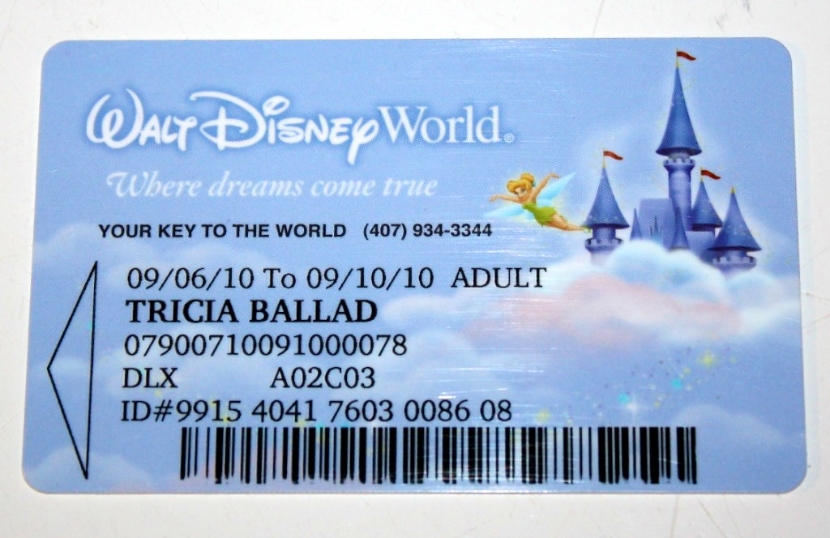
Disney – Data Warehouse Stage
ROLE OF DATA: How much did our customers spend? How can we understand different customer types?

Slide 15
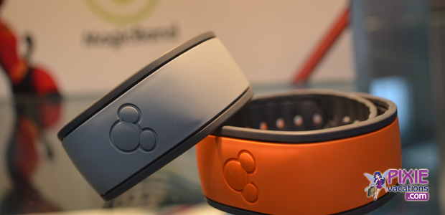
Disney – Big Data
ROLE OF DATA: What path did customers take through the park, when did they leave? How long did they stand in line? When did they spend money on souvenirs and where? How often did they go to the bathroom and did they have to wait? How long did they spend at dinner in the Mexican pavilion compared with the German pavilion? How does the speed of entry correlate with tipping behavior?

Slide 16

Web as Information Source
Google processes about 24 petabytes (1PB=1024 TB)
of information a day
Approximate size of web
1024 petabytes (1 exobyte)
To think of it easier; if you filled a room that was 8' X 10' X 8' (ceiling) you could fit about 450 or so hard drives in there. Assuming you used even 2 TB hard drives you would still need over 1000 of those rooms filed to " download the internet".
http://wiki.answers.com/Q/How_large_is_the_Internet

Slide 17
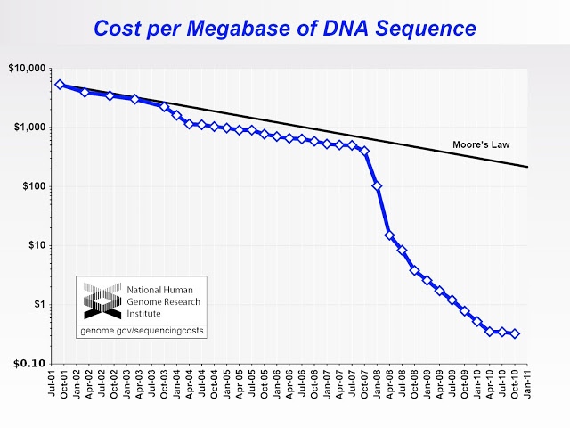

Big Data eScience
“To store the Big Data the Murchison Widefield Array produces, you’d need almost three 1 TB hard drives every two hours,” said Prof. Wicenec. “The technical challenge isn’t just in saving the observations but how you then distribute them to astronomers from the MWA team in far-flung places so they can start using it.”

Slide 18

Big Data and Astronomy
“To store the Big Data the MWA produces, you’d need almost three 1 TB hard drives every two hours”
Source: http://www.skatelescope.org/news/pawsey-centre/

Slide 19
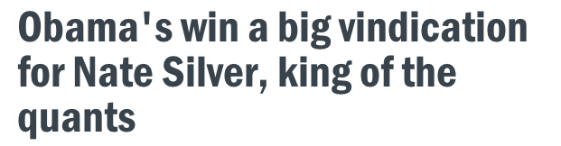
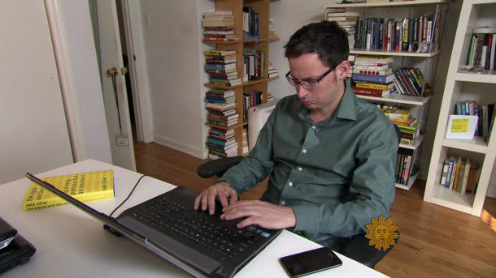
“Despite some incredulous political pundits, the FiveThirtyEight statistician appears to have correctly predicted the winner in all 50 states in the presidential election.”
Source: http://news.cnet.com/8301-13510_3-57546161-21/obamas-win-a-big-vindication-for-nate-silver-king-of-the-quants/

Slide 20




Big Data and Entrepreneurs

Slide 21
By Darryl Leewood (Own work) [CC BY-SA 3.0 (http://creativecommons.org/licenses/by-sa/3.0)], via Wikimedia Commons
Trailer http://www.youtube.com/watch?v=AiAHlZVgXjk

Slide 22
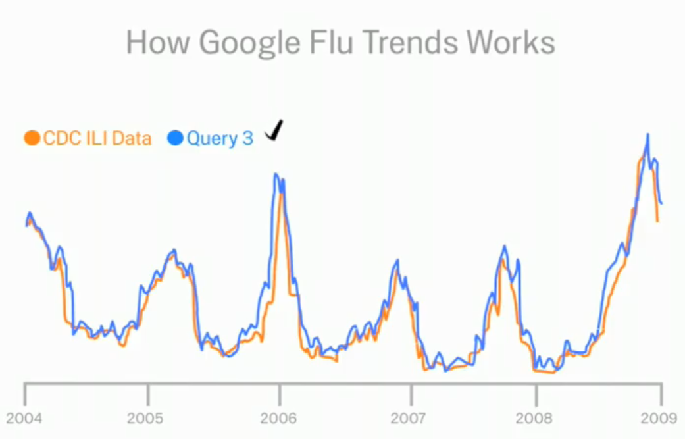
Google Flu Trends
http://www.google.org/flutrends/about/how.html

Slide 23
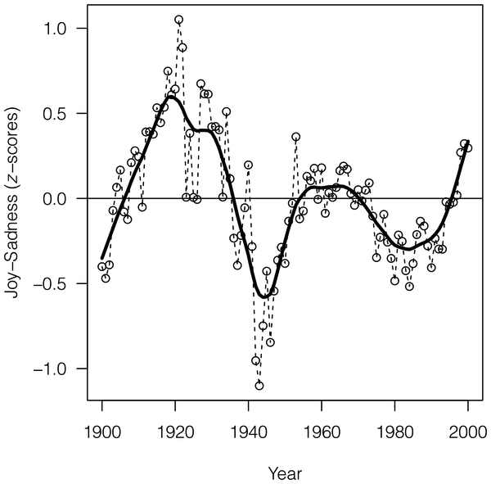
The Expression of Emotions in 20th Century Books
“using the data set provided by Google that includes word frequencies in roughly 4% of all books published up to the year 2008. We find evidence for distinct historical periods of positive and negative moods”
Source: http://www.plosone.org/article/info:doi/10.1371/journal.pone.0059030

Slide 24
The Internet, the Original Big Data Problem
“PageRank works by counting the number and quality of links to a page to determine a rough estimate of how important the website is. The underlying assumption is that more important websites are likely to receive more links from other websites.”
- From "Facts about Google and Competition” via Wikipedia [https://en.wikipedia.org/wiki/PageRank].

Slide 25
What are Other Examples of Analytics Changing the World?

Slide 26
Data science is hard.

Slide 27
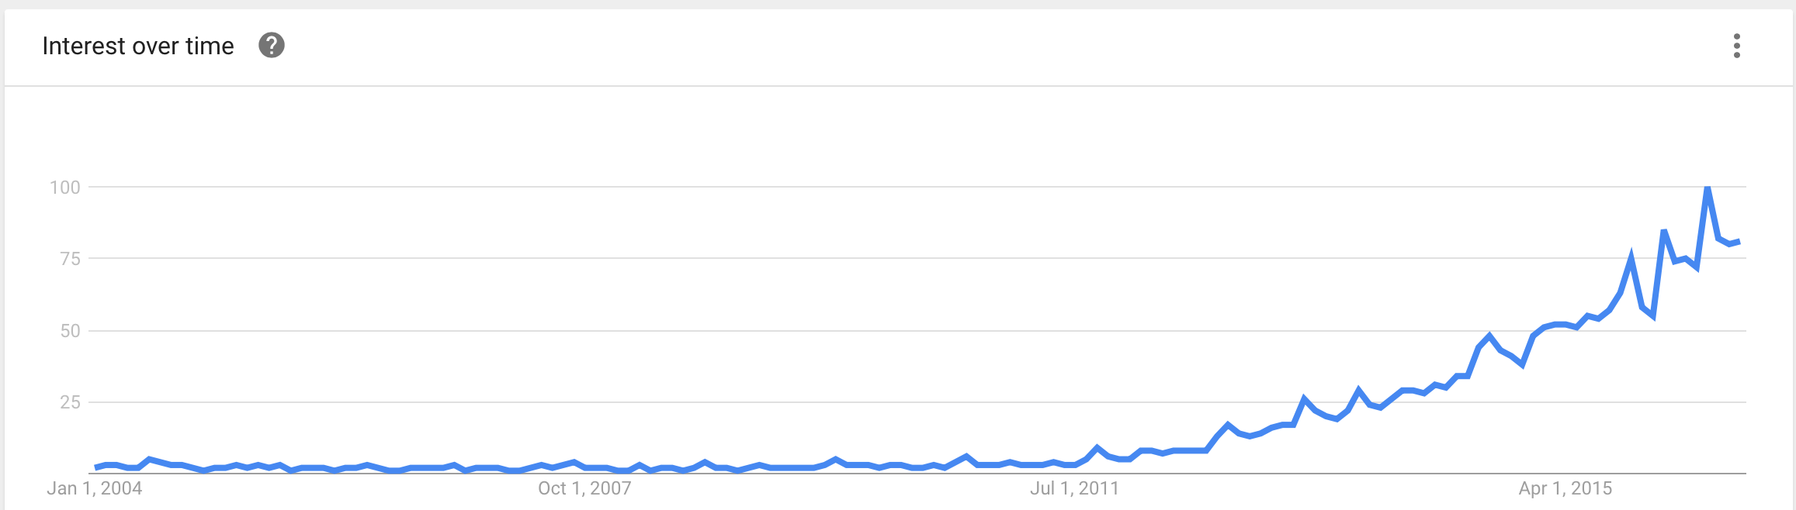
What is a “Data Scientist”?
Accessed from Google Trends on 8/26/2016

Slide 28
“There’s a joke running around on Twitter that the definition of a data scientist is ‘a data analyst who lives in California.’”
— Malcolm Chisholm
From: http://bigdata-madesimple.com/what-is-a-data-scientist-14-definitions-of-a-data-scientist/ by Baiju NT

Slide 29
Data scientists are “analytically-minded, statistically and mathematically sophisticated data engineers who can infer insights into business and other complex systems out of large quantities of data.”
— Steve Hillion
From: http://bigdata-madesimple.com/what-is-a-data-scientist-14-definitions-of-a-data-scientist/ by Baiju NT

Slide 30
What skills are needed as a data scientist?

Slide 31
Key Tools of the Data Scientist
Basic Tools (R & PYTHON & SQL)
Basic Statistics
Machine Learning
Multivariable Calculus and Linear Algebra
Data Munging
Data Visualization & Communication
Software Engineering
Thinking Like A Data Scientist
From: http://blog.udacity.com/2014/11/data-science-job-skills.html

Slide 32
Data Science Venn Diagram
Hacking Skills
Math & Statistics Knowledge
Substantive Expertise
Source: http://drewconway.com/zia/2013/3/26/the-data-science-venn-diagram

Slide 33
Tool | 2016
 | % share | % change
R | 49% | 4.50%
Python | 45.80% | 51%
SQL | 35.50% | 15%
Excel | 33.60% | 47%
RapidMiner | 32.60% | 3.50%
Hadoop | 22.10% | 20%
Spark | 21.60% | 91%
Tableau | 18.50% | 49%
KNIME | 18.00% | -10%
scikit-learn | 17.20% | 107%
TOP SOFTWARE TOOLS FOR DATA SCIENCE
KD Nuggets http://bit.ly/kd2016top

Slide 34
Abstractions vs Tools
Abstractions of data science
Matrices and linear algebra
Relations and relational algebra
MapReduce
Feature selection in Visualization
Tools
Python/R
SQL/MongoDB
Spark/Hadoop (MapReduce)
Tableau (Visualization)

Slide 35
“Analytics is the discovery and communication of meaningful patterns in data.” -Wikipedia

Slide 36
We can discover meaning through visualization, statistics, and machine learning Data comes in normal and big data

Slide 37
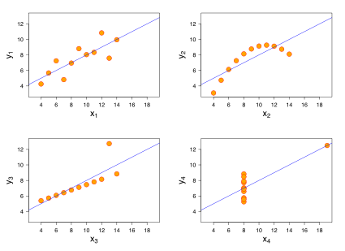
Why Visualize?
All 4 sets for variables have the same mean, standard deviation, and correlation, and regression line

Slide 38
 | Goals
Statistics | EXPLAIN the role of specific constructs
Machine Learning | CALCULATE an ACCURATE PREDICTION

Slide 39
Statistical Models
Provide explanations for things
What is the role of gender in school performance
Which groups perform better
What foods reduce your likelihood of dying
Estimate magnitude of effect
How much does an increase in police reduce crime?
How much does spending on education influence student performance?

Slide 40
Correlation does not imply causation.
A good final note for statistics…next on to machine learning…

Slide 41
"Field of study that gives computers the ability to learn without being explicitly programmed”
-Arthur Samuel (on machine learning)

Slide 42
\
Incumbant
Survey
Machine Learning Algorithms
Model Selection
Retrain Web Service
Trained Model
Prediction
Survey
Web Service
Input
Web Service
Output

Slide 43
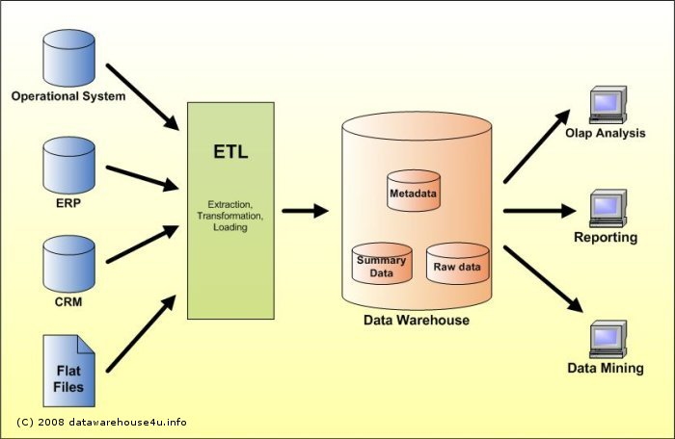
Big Data 1.0

Slide 44
Big Data 1.0
Online Transaction Processing Systems (OLTP)
CRM, ERP, etc
Extract, Transform, Load (ETL)
Extract data from all OLTP systems and put into a Data Warehouse
Data Warehouse
System for creating reports, exploring existing data

Slide 45
Data Warehouse Limitations
Not setup for extremely large datasets
Weblogs capturing all data
Data can be too large to hold in memory for a single location
Data from non-transactional sources (Twitter, logs, email) doesn’t fit as well with

Slide 46

Big Data 2.0

Slide 47
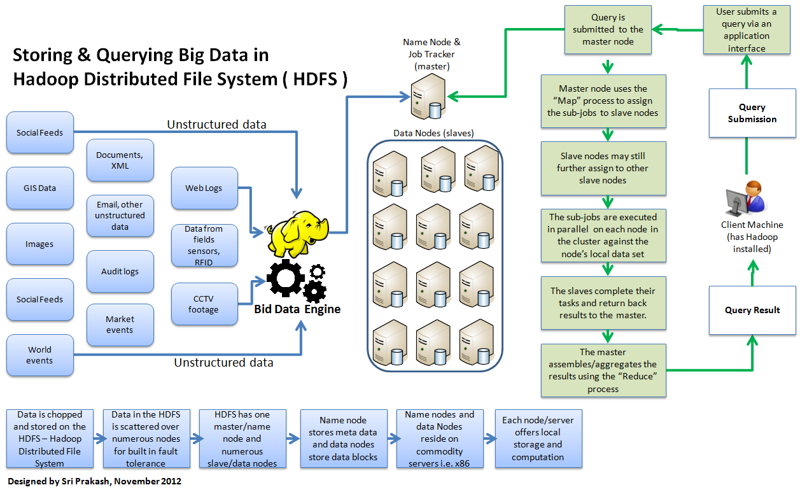
HADOOP and HDFS

Slide 48
It takes time to get good at data science.

Slide 49
Tips for Learning New Skills
Clarify terminology, mental models for what is being done conceptually
Watch videos and lectures
Practice – DO IT! Set aside time for practice
Kaggle Competitions

Slide 50
1. Understand why you are doing something. 2. Read the error message. 3. Google the error message. 4. Consider other methods. 5. Ask for help.

Slide 51
When R and when Python? (Or why do I need both?)

